Slide 1

Breast Cancer Detection

Slide 2

Team Members
Asmaa Adel Omar
ID: 20180460
Abdelkarim Al-Dali GasmEl-bari
ID: 20180428
Ameen Fouad
ID: 20180398

Slide 3
Agenda
Overview
Data Exploration using Python
RapidMiner
Python
Accuracy Comparison
Conclusion

Slide 4

Overview
Features are computed from a digitized image of a fine needle aspirate (FNA) of a breast mass. They describe characteristics of the cell nuclei present in the image.
Predict whether the cancer is benign or malignant using some classification algorithms

Slide 5
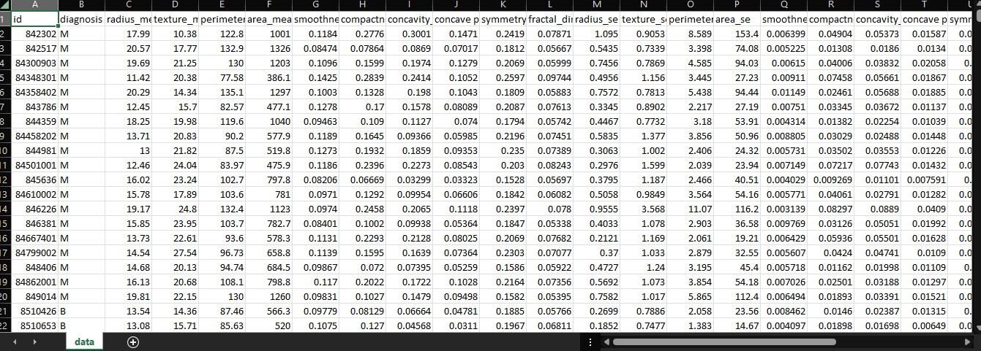
Data Set shape(569,33)

Slide 6
Data Exploration
We prepared data using “Python”.
There’s no missing values or duplicated values.
We use the describe() function to have a summary statistics.

Slide 7
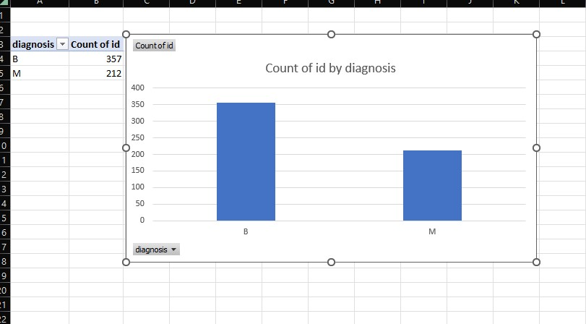
chart

Slide 8
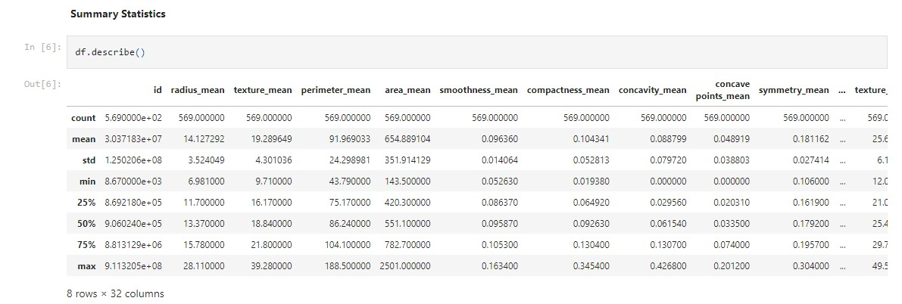
Summary statistics

Slide 9
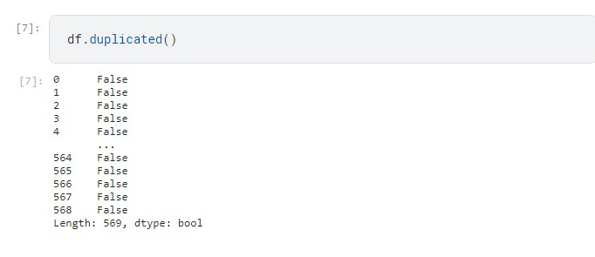
Data exploration

Slide 10
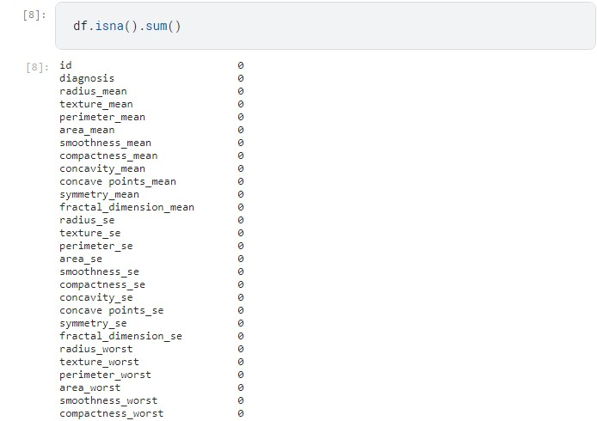
Data exploration

Slide 11
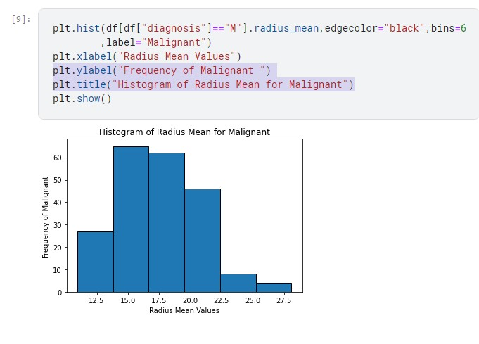
Data exploration

Slide 12
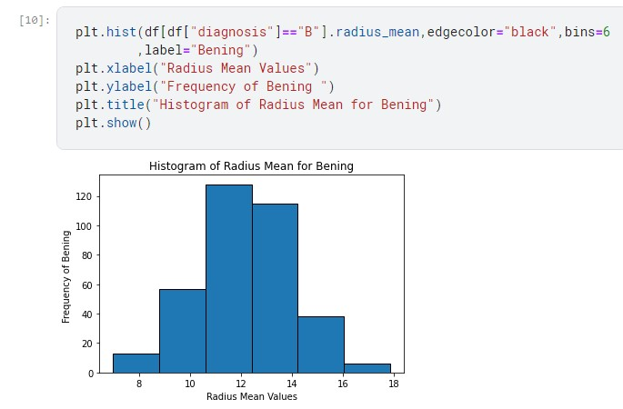
Data exploration

Slide 13
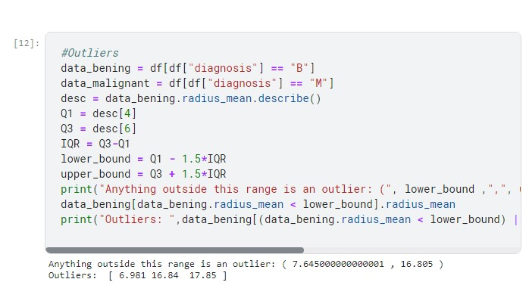
Data exploration

Slide 14
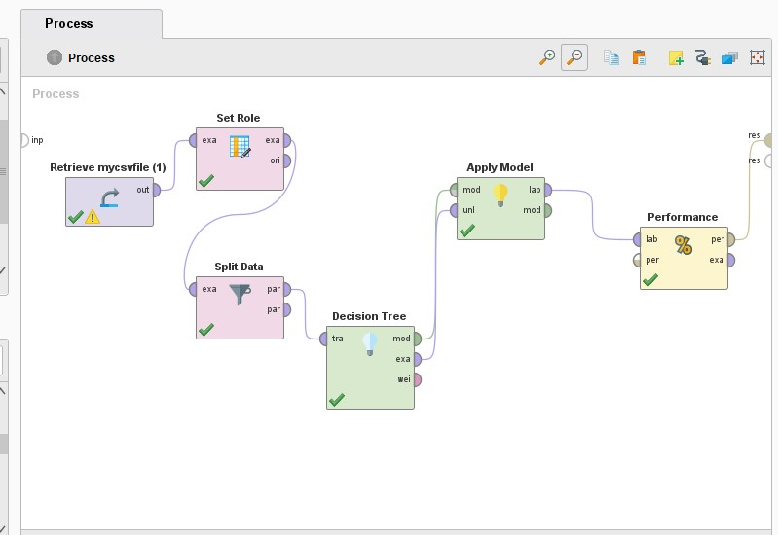
Rapid miner(Decision Tree)

Slide 15
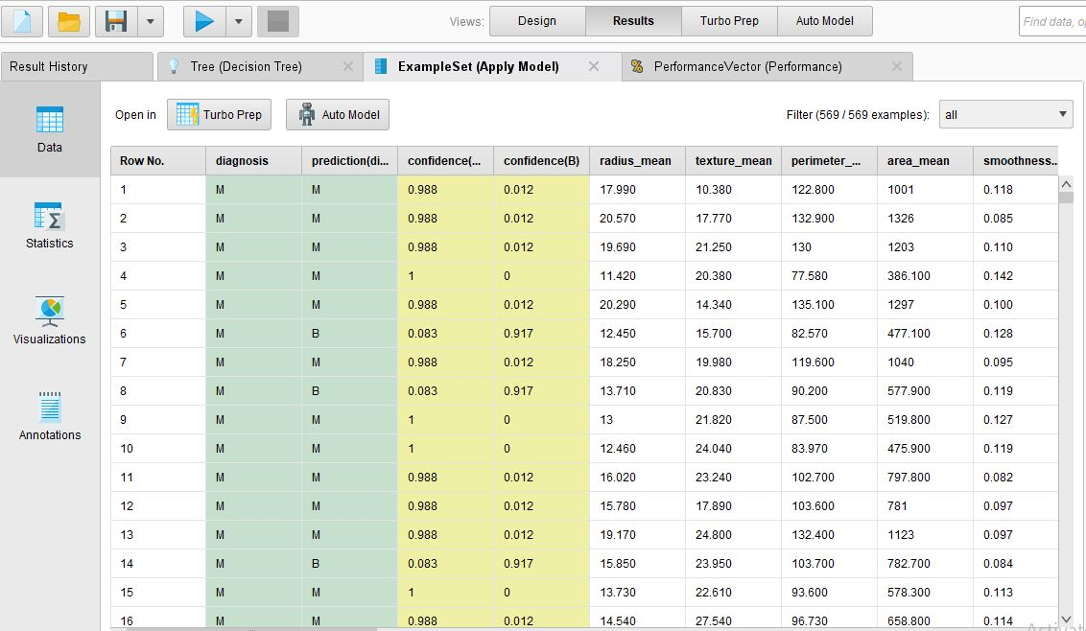
Rapid miner(Decision Tree)

Slide 16
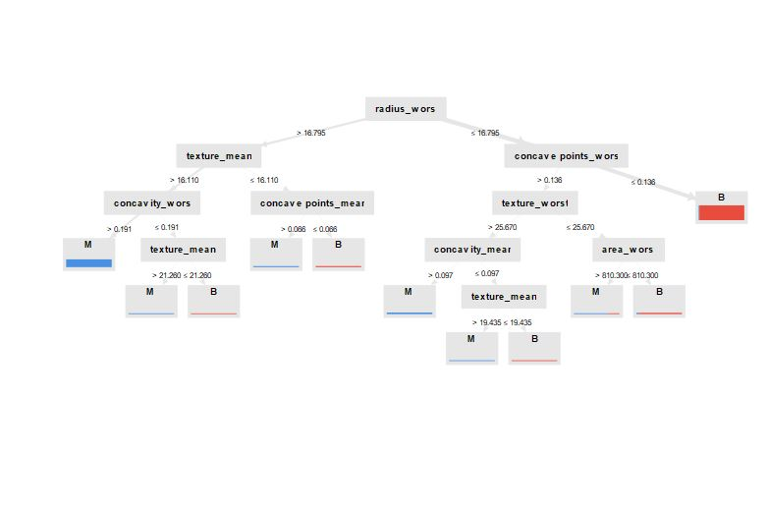
Rapid miner(Decision Tree)

Slide 17
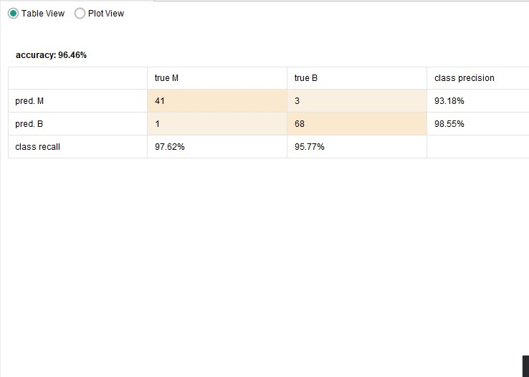
Rapid miner(Decision Tree)

Slide 18
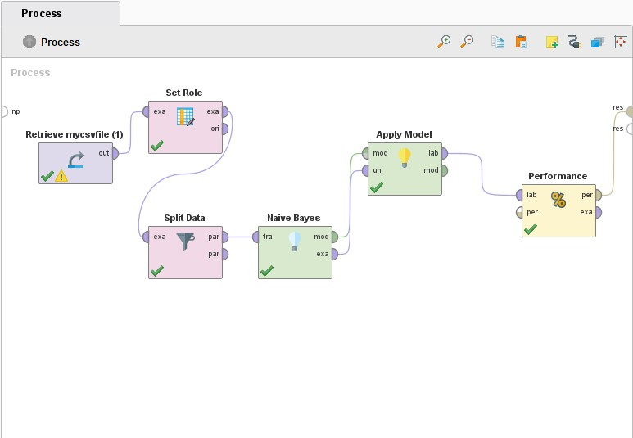
Rapid miner(Naïve Bayes)

Slide 19
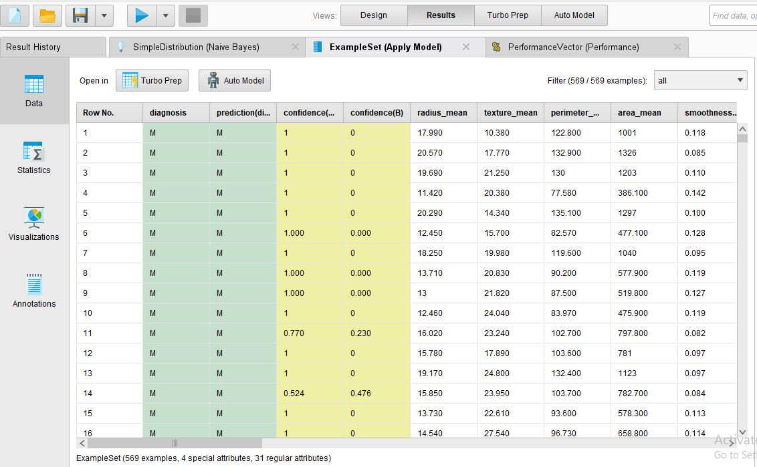
Rapid miner(Naïve Bayes)

Slide 20
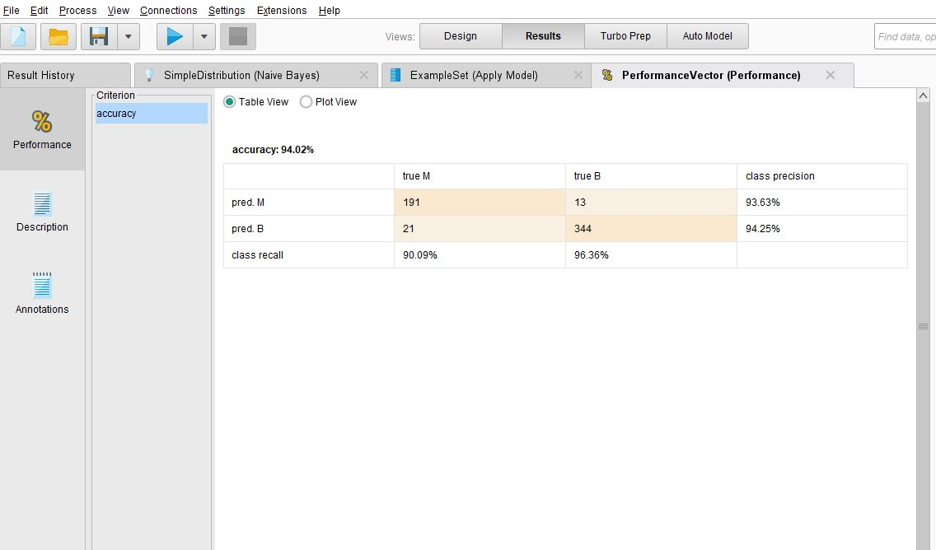
Rapid miner(Naïve Bayes)

Slide 21
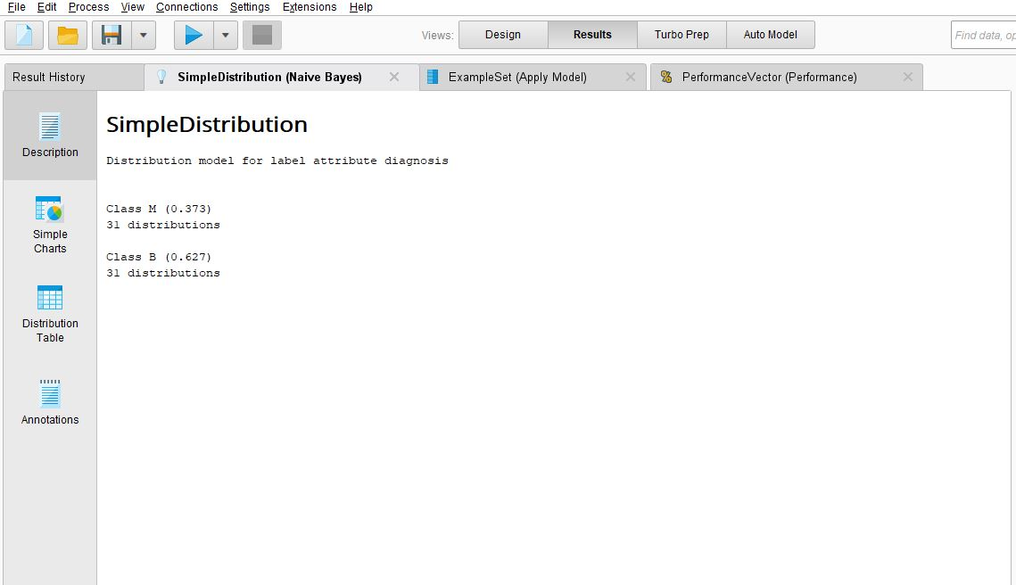
Rapid miner(Naïve Bayes)

Slide 22
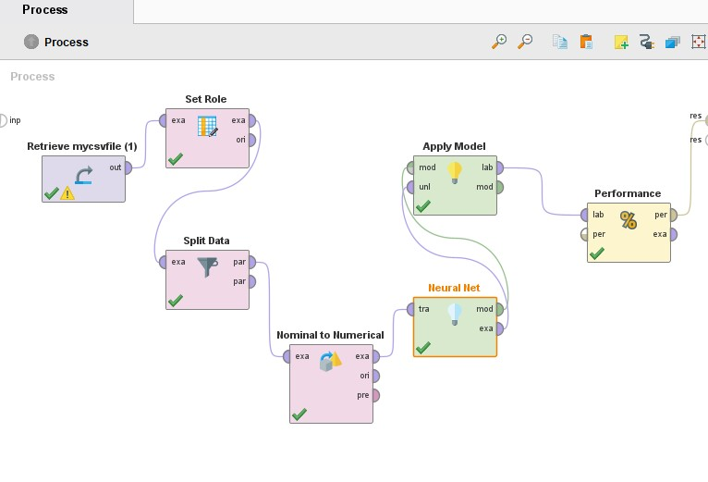
Rapid miner(Neural Network)

Slide 23
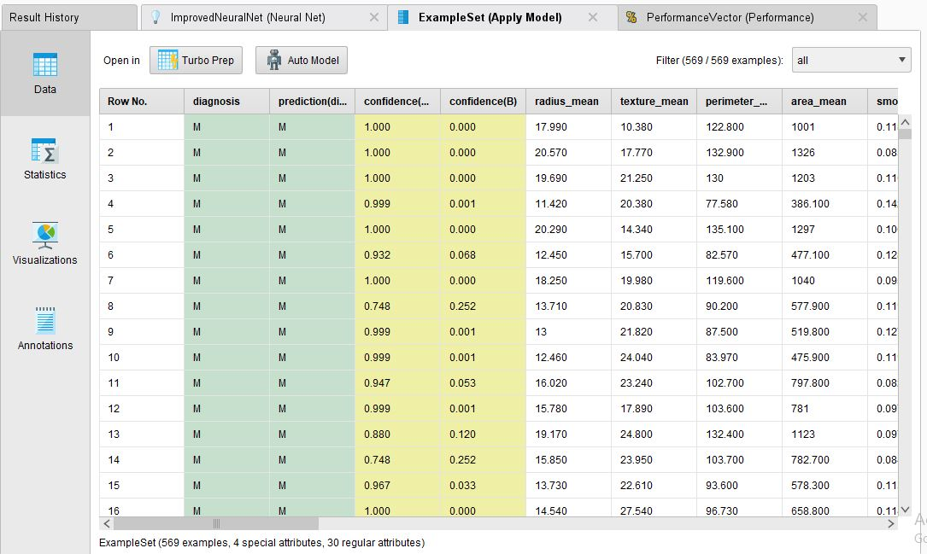
Rapid miner(Neural Network)

Slide 24
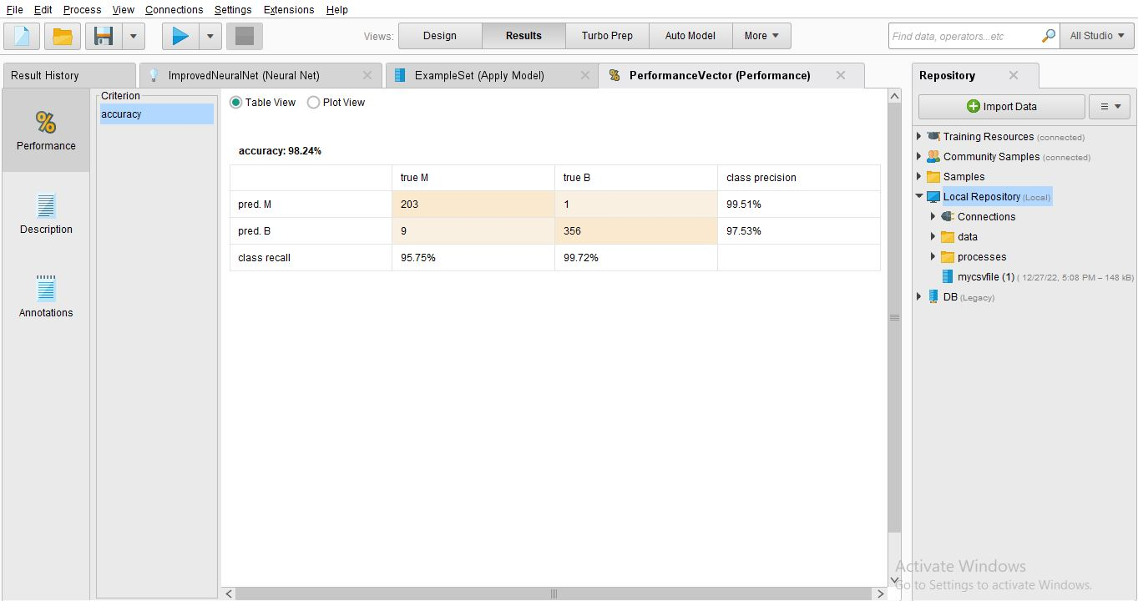
Rapid miner(Neural Network)

Slide 25
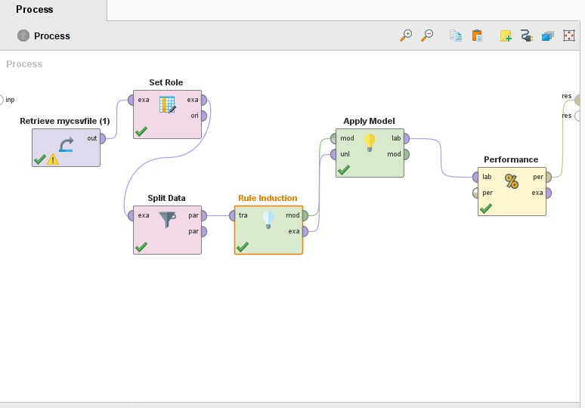
Rapid miner(Rule induction)

Slide 26
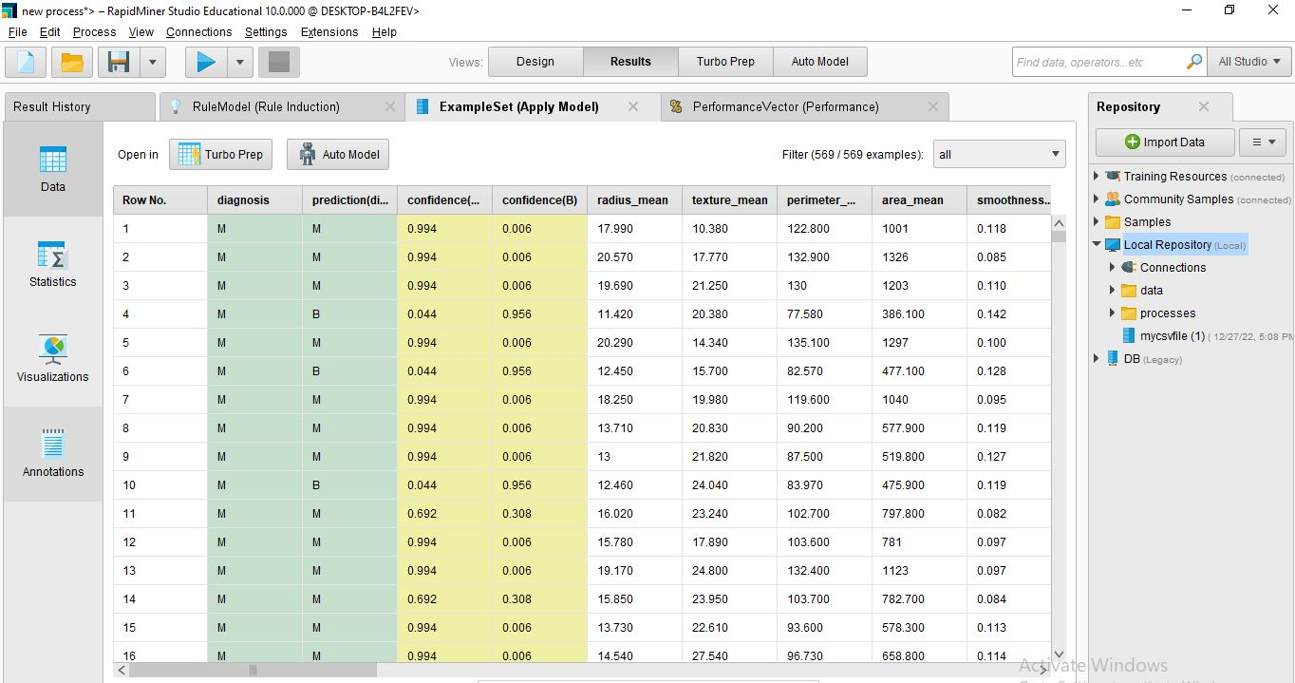
Rapid miner(Rule induction)

Slide 27
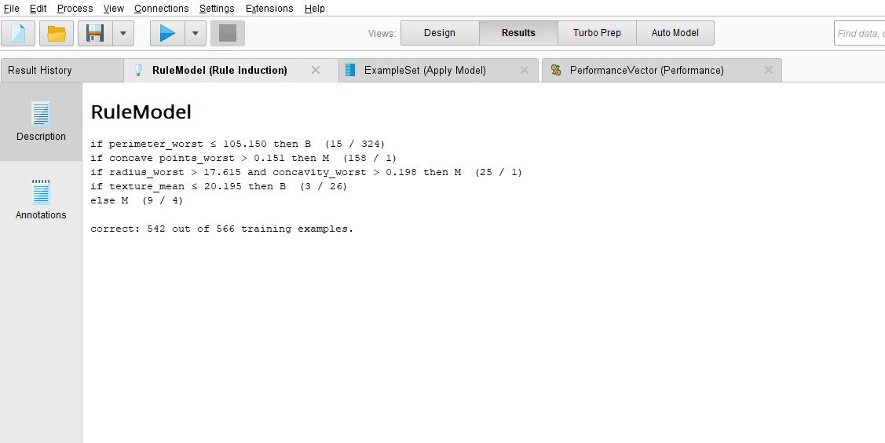
Rapid miner(Rule induction)

Slide 28
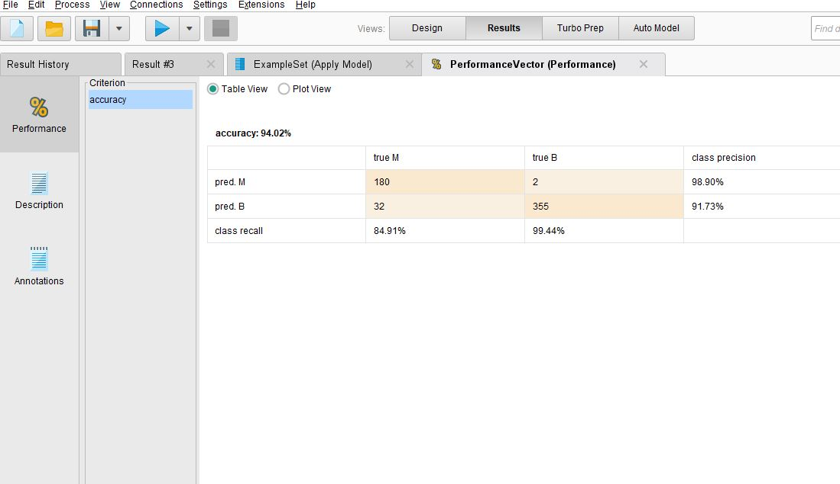
Rapid miner(Rule induction)

Slide 29
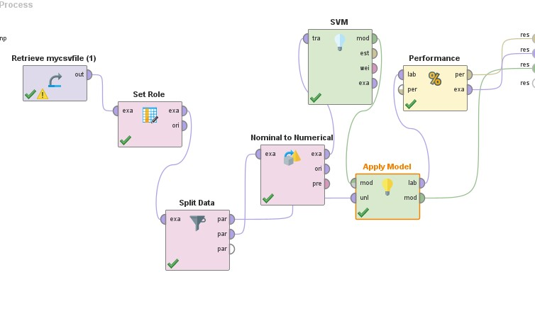
Rapid miner(SVM)

Slide 30
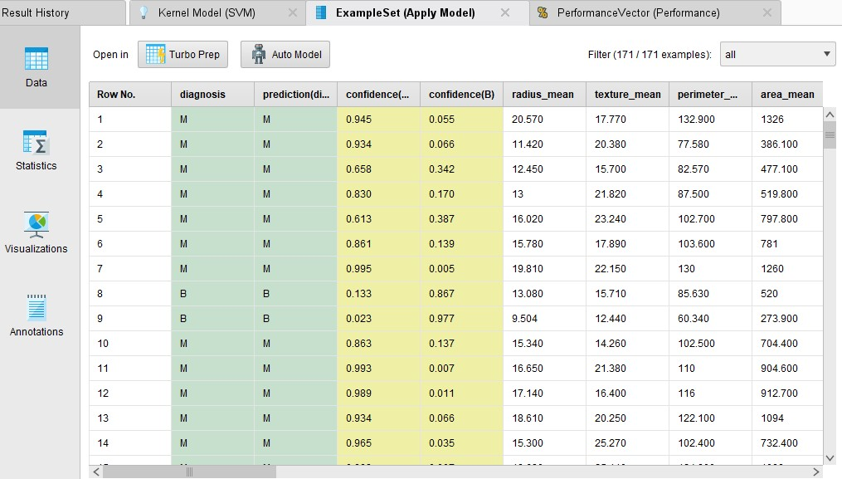
Rapid miner(SVM)

Slide 31
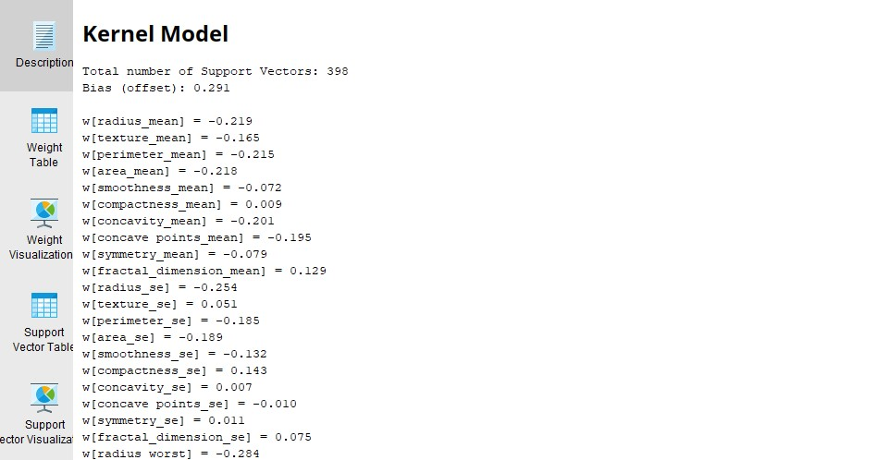
Rapid miner(SVM)

Slide 32
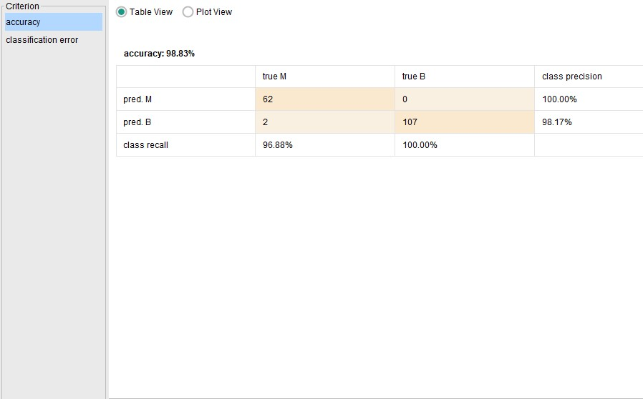
Rapid miner(SVM)

Slide 33
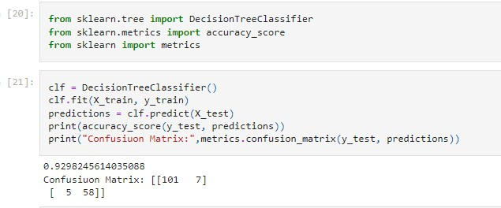
Python (Decision Tree)

Slide 34
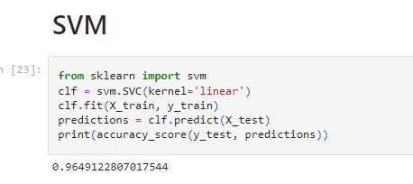
Python (SVm)

Slide 35
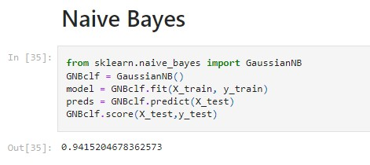
Python (Naïve bayes)

Slide 36
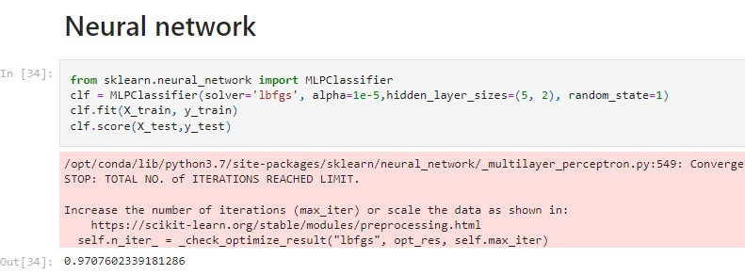
Python (Neural network)

Slide 37
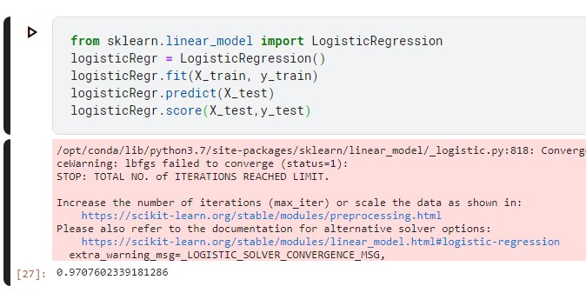
Python (Logistic Regression)

Slide 38
Accuracy comparison
Rapid Miner | Accuracy
SVM | 98.83%
ANN | 99.24%
Decision Tree | 95.61%
Rule Induction | 94.02%
Naïve Bayes | 94.02%

Slide 39
Accuracy comparison
Python | Accuracy
Decision Tree | 92.98%
Naïve Bayes | 94.15%
SVM | 96.49%
ANN | 97.07%
Logistic Regression | 97.07%

Slide 40

Conclusion
From both “Rapid Miner” and “Python” we find the Neural Network algorithm got the highest accuracy so for future we will use them for breast cancer classification problem.

Slide 41

Thank you

